Slide 1

JavaFX – Past, Present, Future
By
Doychin Bondzhev
doychin@dsoft-bg.com

Slide 2
Before JavaFX
AWT
  Introduced with Java 1.0
  Thin layer over platform native UI controls
  Platform specific look and feel
Swing
  Introduced with Java SE 1.2
  Richer control set. Support for different L&F independent from platform
  Good only for Desktop applications

Slide 3
Java FX past
First introduced in 2008 as JavaFX 1.0
  Based on JavaFX Script
Later versions added support for Mobile, Linux & Solaris
In 2011 Oracle released JavaFX 2.0
  Based on Java API instead of JavaFX Script
  Initially targeting Windows
  Later versions added Linux and Mac support
Java FX is part of Java SE version 7 update 6
Some parts of JavaFX platform are available as open source

Slide 4
JavaFX Present
Part of JRE/JDK 8
  Provides support for Windows, Linux and Mac
  Supported only on x86 platforms
  There are third party support for Android and iOS from open source project JavaFX Ports (http://gluonhq.com/open-source/javafxports/)

Slide 5
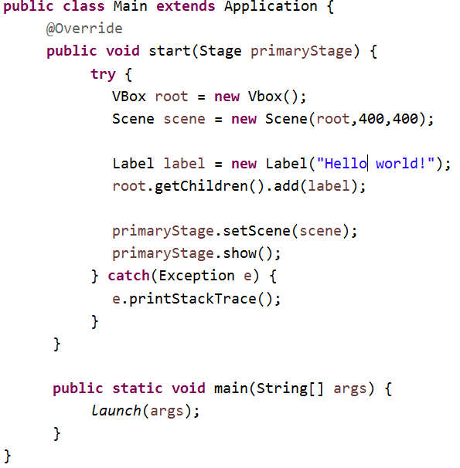
JavaFX Application
Stage – main application window
Scene – Window content
VBox – Scene layout

Slide 6
JavaFX Layouts
VBox – positions controls vertically
HBox – positions controls horizontally
BorderPane – Top, Bottom, Left, Right
GridPane – Places controls on a grid
FlowPane – Flow layout
AnchorPane
TilePane
StackPane

Slide 7
JavaFX Controls
Full set of standard controls
  Label, TextField, TextArea, Button, CheckBox, ComboBox, RadioButton, ListVew, ImageView
  And more...
WebView – fully featured Web browser based on WebKit
Different shapes
  Line, Rectangle, Circle, Ellipse and more
Charts
  AreaChart, BarChart, BubbleChart, LineChart, PieChart
  And more....
New in JavaFX 8 is support for 3D

Slide 8
JavaFX and Swing
SwingNode – allows to use Swing controls in JavaFX scene
JFXPanel – allows to use JavaFX controls in Swing form
Implications when mixing JavaFX and Swing
  Each framework uses his own event thread.
  When changing state of Swing or JavaFX controls this must happen in the corresponding event thread.

Slide 9
JavaFX & SWT
javafx.embed.swt.FXCanvas – JavaFX provides support to embed JavaFX content in SWT application

Slide 10
CSS in JavaFX
JavaFX allows to use CSS to style your controls
.button1 {
-fx-text-fill: #006464;
-fx-background-color: #DFB951;
-fx-border-radius: 20;
-fx-background-radius: 20;
-fx-padding: 5;
}

Slide 11
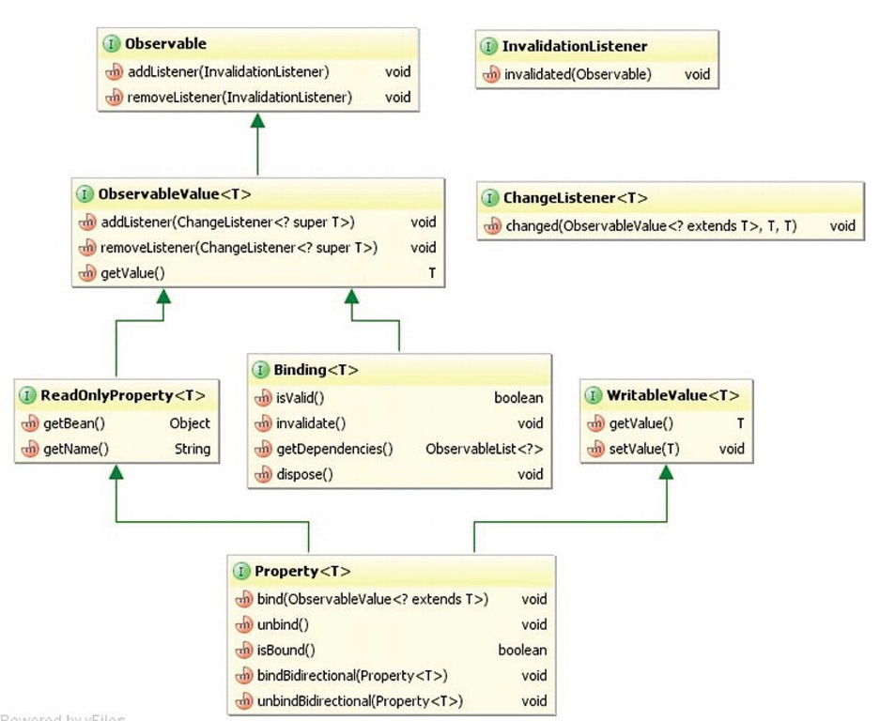
JavaFX Properties & Bindings
New properties & bindings library

Slide 12
JavaFX Properties & Bindings
Full set of predefined classes for different property types
  Standard object types: SimpleStringProperty, SimpleIntegerProperty, SimpleBooleanProperty, SimpleDoubleProperty, SimpleFloatProperty, SimpleLongProperty
  Collections: SimpleListProperty<E>, SimpleMapProperty<K, V>, SimpleSetProperty<E>
  SimpleObjectProperty<E>

Slide 13
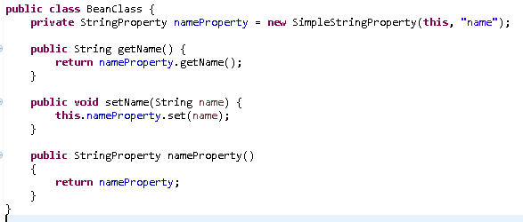
How to define a property
Sample property definition

Slide 14
Bindings
Unidirection bindings
  Methods in Property class
    bind()
    unbind()
    isBound()
Bidirectional bindings
  Methods in Property class
    bindBidirectional()
    unbindBidirectional();
Expression bindings
  Class javafx.beans.binding.Bindings

Slide 15
SceneBuilder
WYSIWYG tool to build your forms
Produces FXML file – View in MVC
Clean separation between View and Controller
Integrates with all Java IDE's
Initially developed by Oracle
Released as open source
Binaries are available by Gluon(http://gluonhq.com/open-source/scene-builder/)

Slide 16
Tools support for Java FX
NetBeans from version 7.1.1
IntelliJ
Eclipse – e(fx)clipse provides support for JavaFX development
  https://www.eclipse.org/efxclipse/index.html

Slide 17
JavaFX resources
JavaFX at Oracle - http://docs.oracle.com/javafx/
GluonHQ - http://gluonhq.com/
YouTube – lots of tutorials about JavaFX
OpenjFX Project - http://openjdk.java.net/projects/openjfx/
JavaFX Wikipedia - https://en.wikipedia.org/wiki/JavaFX

Slide 18
JavaFX Q&A
Any questions?

Slide 19
Thank you !!!
Doychin Bondzhev
  doychin@dsoft-bg.com

